Slide 1

Planning and implementation of air quality plans and programms
Ministry for Agriculture and Environment
Mag. Tanja BOLTE
Mag. Jože JURŠA

Slide 2



Legislations
Ustava RS Slovenije
Zakon o varstvu okolja
Direktiva 2008/50/ES (24. in 23. člen)
Uredba o kakovosti zunanjega zraka
Pravilnik o ocenjevanju kakovosti zunanjega zraka
Sklep o določitvi podobmočji zaradi upravljana s kakovostjo zunanjega zraka
Odredba o določitvi območja in razvrstitvi območij, aglomeracij in podobmočij glede na onesnaženost zunanjega zraka

Slide 3
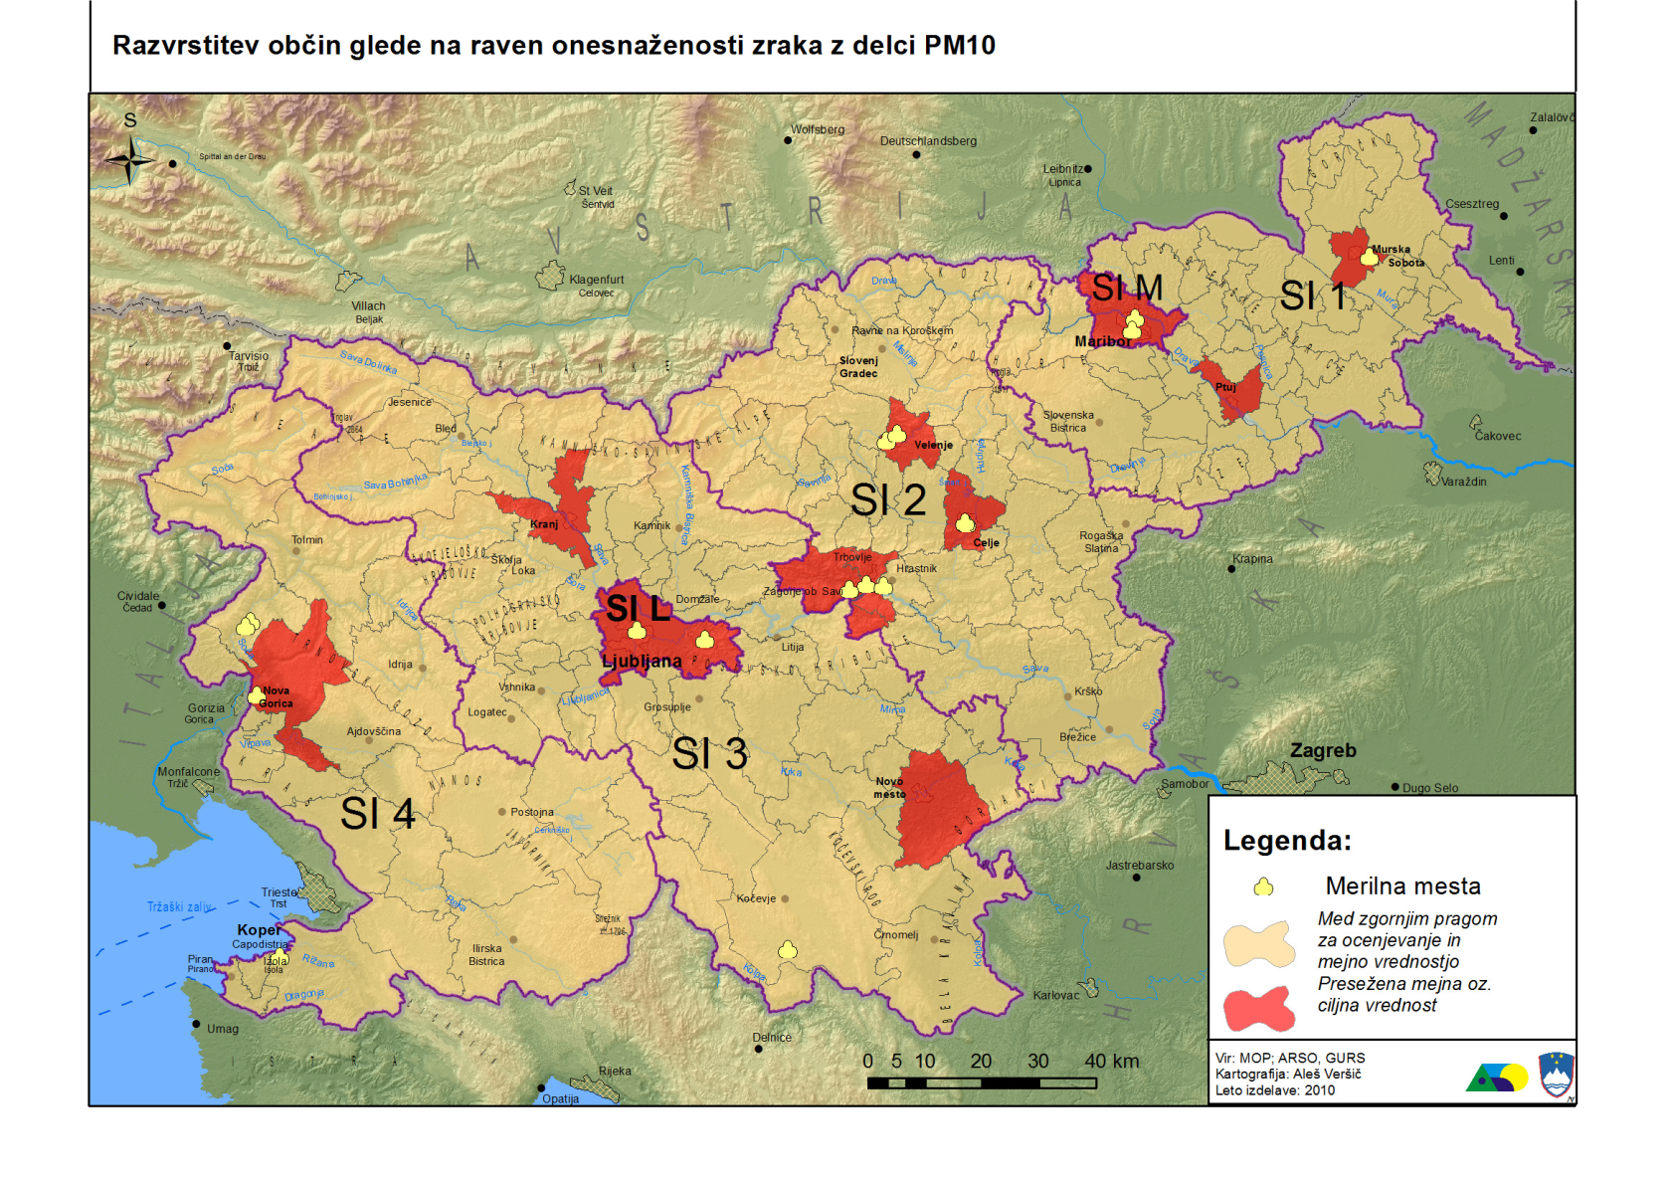
Air quality

Slide 4
Concentrations of PM10

Slide 5
Number of exceedances PM10

Slide 6
Air quality plan
The AQP consist of two parts:
A legal act and
annex containing:
The description of exessive pollution areas
Situation analysis of pollution
Sources of pollution
The impact of pollution sources
Pollution abatement measures
The responisble authorities forthe implementation of measures.

Slide 7
Measures
The masures focus on the areas of energy and traffic.
promotion energy efficiency and renewable energy
In the transport sector (city bus fleet to the EEV standard, various traffic reducing measurements)
Other sectors
Public information!
The measures and the necessary financial resources will be identified in the annual programs

Slide 8
Financial resources
Financial perspective (2014-2020)
Climate found
Founding for the seven air qualty plans 340 mio EUR.

Slide 9
Conclusions
Ambition is that two years, air quality improved dramatically in the three years of air quality with the requirements of Directive
It will not be possible without the cooperation between state, local communities and other steckholders

